Slide 1
America’s Love Affair with Food
Diabetes, Obesity, Heart Disease
and Health Costs
Sam Pardue, FSLI Director
SLP2021

Slide 2
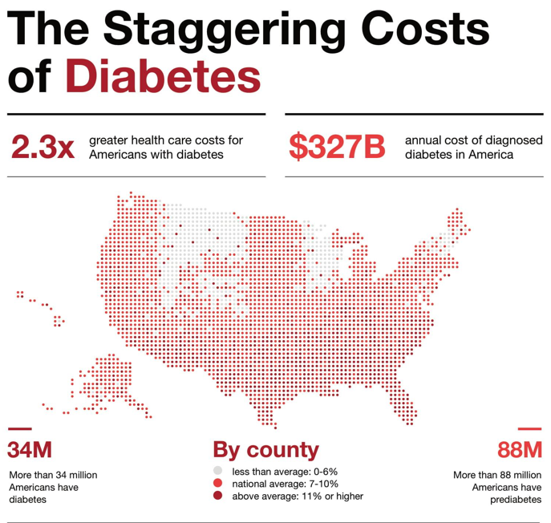
https://www.diabetes.org/resources/statistics/cost-diabetes
SLP2021

Slide 3
Diabetes
https://www.diabetes.org/resources/statistics/cost-diabetes
SLP2021

Slide 4
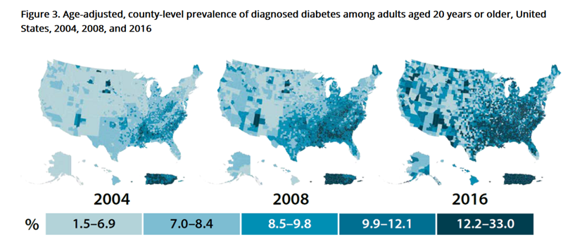
Diabetes
https://www.cdc.gov/diabetes/data/statistics-report/diagnosed-diabetes.html
SLP2021

Slide 5
Obesity is a common, serious, and costly disease
The US obesity prevalence was 42.4% in 2017 – 2018.
From 1999 –2000 through 2017 –2018, US obesity prevalence increased from 30.5% to 42.4%. During the same time, the prevalence of severe obesity increased from 4.7% to 9.2%.
Obesity-related conditions include heart disease, stroke, type 2 diabetes and certain types of cancer. These are among the leading causes of premature death.
https://www.cdc.gov/obesity/data/adult.html
SLP2021

Slide 6
Economic Costs of Obesity
The estimated annual health care costs of obesity-related illness are a staggering $190.2 billion or nearly 21% of annual medical spending in the United States. Childhood obesity alone is responsible for $14 billion in direct medical costs.
https://www.healthycommunitieshealthyfuture.org/learn-the-facts/economic-costs-of-obesity/
SLP2021

Slide 7
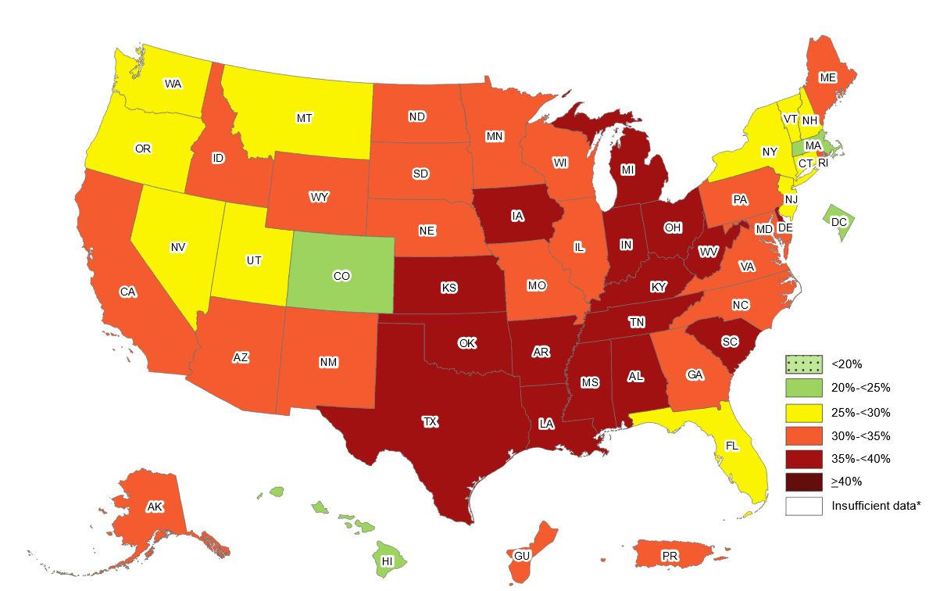
Prevalence of Obesity Among U.S. Adults 2020
https://www.cdc.gov/obesity/data/prevalence-maps.html#overall
SLP2021

Slide 8
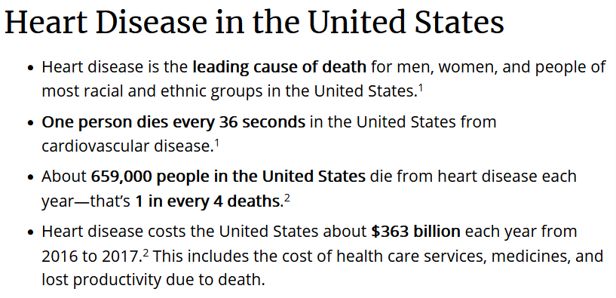
https://www.cdc.gov/heartdisease/facts.htm
SLP2021

Slide 9
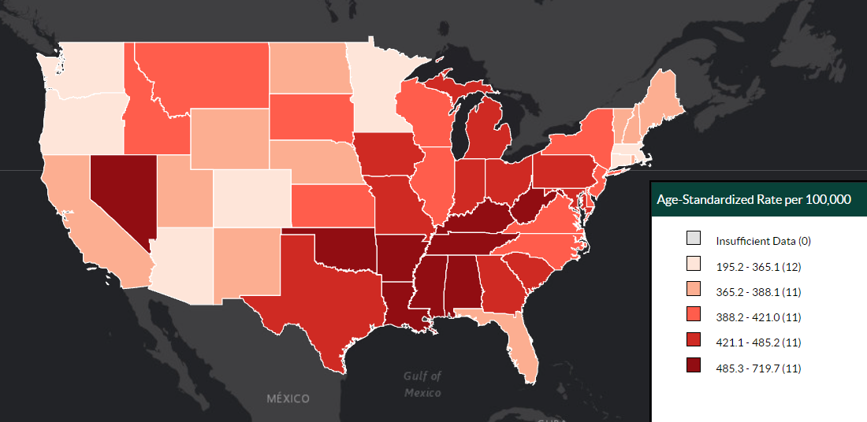
Total Cardiovascular Disease Deaths
Interactive Atlas of Heart Disease and Stroke (cdc.gov)
SLP2021

