Slide 1
Ten Years to Midnight
Four urgent global crises and their strategic solutions
Blair Sheppard Global Leader, Strategy and Leadership PwC

Slide 2
A
D
A
P
T
Asymmetry
Increasing wealth disparity and the erosion of the middle class
Disruption
The impacts of technology, climate change and disruptive events on individuals, society and businesses
Age
Demographic pressure on business, social institutions and economies
Polarisation
Breakdown in global consensus and a fracturing world, with growing nationalism and populism
Trust
Declining confidence in the institutions that underpin society
Notes:
Feb 20222

Slide 3
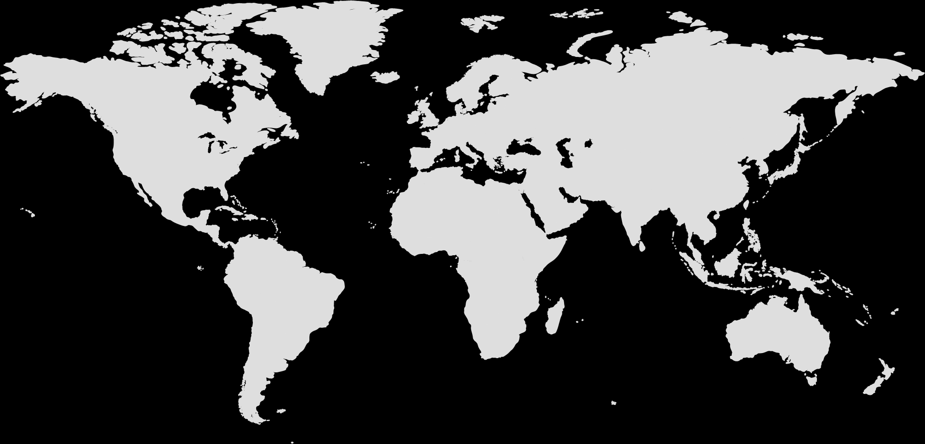
This highlighted four global crises
1
2
3
4
Crisis of prosperity
Crisis of technology
Crisis of institutional legitimacy
Crisis of leadership

Slide 4
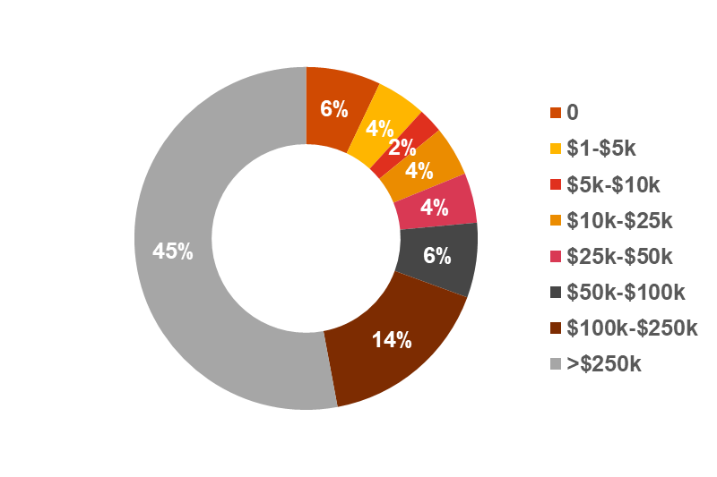
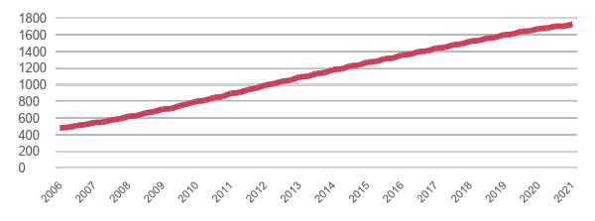
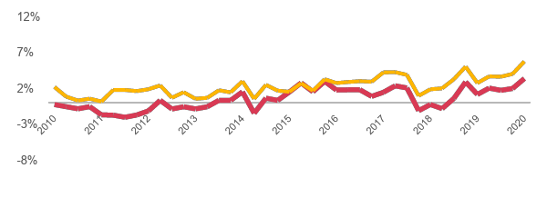
The crisis of prosperity
Young and falling behind
Retiring broke
Student Loans Outstanding USD Billions
Household retirement savings of US babyboomers (2020,%)
Source: Board of Governors of the Federal Reserve System
Source: Transamercia Center for Retirement Studies, 21st Annual Transamerica Retirement Survey of Workers
The squeezed middle
Regional disparity
Nominal vs. Real Wage Growth 2010-2020
US Median Household Income by State, 2020
<$50,000
$50,00-$59,000
$60,000-$69,000
Median $67,521
$70,000-$79,000
$80,000+
Source: US Bureau of Labor or Statistics/FRED
Source: US Census Bureau
Notes:
Student loan debt rose from $480.1 billion (3.5% GDP) in Q1 2006 to $1,683 billion (7.8% GDP) in Q1 2020.
Data:
Student loans: https://www.federalreserve.gov/releases/g19/hist/cc_hist_memo_levels.html
Real vs nominal wages: Employed full time: Median usual weekly real earnings: Wage and salary workers: 16 years and over (LES1252881600Q): https://fred.stlouisfed.org/series/LES1252881600Q
Employed full time: Median usual weekly nominal earnings (second quartile): Wage and salary workers: 16 years and over (LES1252881500Q): https://fred.stlouisfed.org/series/LES1252881500Q
- Retirement savings: US: https://transamericacenter.org/docs/default-source/retirement-survey-of-workers/tcrs2021_sr_four-generations-living-in-a-pandemic.pdf
Babyboomer = born 1946-1964= aged 58 or above
- US median income by state: https://www.statista.com/statistics/233170/median-household-income-in-the-united-states-by-state/

Slide 5
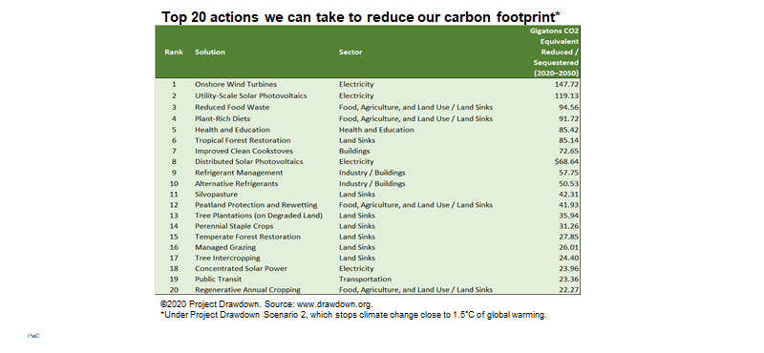
The crisis of technology: climate impacts
Climate solutions
Top 20 actions we can take to reduce our carbon footprint*
Rank | Solution | Sector | Gigatons CO2 Equivalent Reduced / Sequestered (2020-50)
1 | Offshore Wind Turbines | Electricity | 147.72
2 | Utility-Scale Solar Photovoltaics | Electricity | 119.13
3 | Reduced Food Waste | Food, Agriculture, & Land Use / Land Sinks | 94.56
4 | Plant-Rich Diets | Food, Agriculture, & Land Use / Land Sinks | 91.72
5 | Health and Education | Health and Education | 85.42
6 | Tropical Forest Restoration | Buildings | 85.14
7 | Improved Clean Cookstoves | Industry / Buildings | 72.65
8 | Distributed Solar Photovoltaics | Industry / Buildings | 69.64
9 | Refrigerant Management | Land Sinks | 57.75
10 | Alternative Refrigerants | Food, Agriculture, & Land Use / Land Sinks | 50.53
11 | Silvopasture | Land Sinks | 42.31
12 | Peatland Protection and Rewetting | Land Sinks | 41.93
13 | Tree Plantations (on Degraded Land) | Land Sinks | 35.94
14 | Perennial Staple Crops | Land Sinks | 31.26
15 | Temperate Forest Restoration | Land Sinks | 27.85
16 | Managed Grazing | Land Sinks | 26.01
17 | Tree Intercropping | Land Sinks | 24.40
18 | Concentrated Solar Power | Land Sinks | 23.96
19 | Public Transit | Transportation | 23.36
20 | Regeneration Annual Cropping | Food, Agriculture, & Land Use / Land Sinks | 22.27
Expected global surface temperature increase
(2081-2100, relative to 1850-1900)
Emissions headed in the wrong direction
+ 4.4 C
+ 3.6 C
+ 2.7 C
+ 1.8 C
+ 1.4 C
Parallel assumptions for other key non-CO₂ drivers taken into account too
Source: IPCC, 2021, Climate Change 2021: The Physical Science Basis
Source: ©2020 Project Drawdown. www.drawdown.org * Under Project Drawdown Scenario 2, which stops climate change close to 1.5°C of global warming.
Notes:
LHS: Emissions: https://www.ipcc.ch/report/ar6/wg1/downloads/report/IPCC_AR6_WGI_SPM_final.pdf, page 17

Slide 6
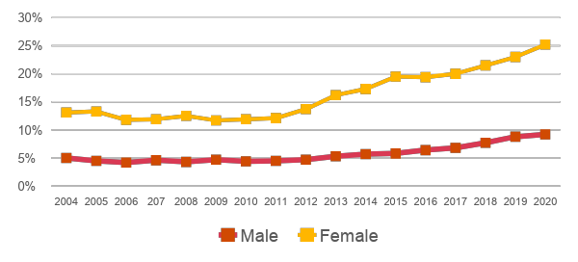
The crisis of technology: challenges for humans
US leads in jobs at risk from automation
AI challenges and potential harms
Potential jobs at high risk of automation by country
AI Policy Challenges
40%
Robots rights
At what about point should machines or robots acquire legal rights (if ever)?
Artificial stupidity
How we avoid critical errors that can cause harm?
35%
30%
25%
20%
Arms race
Should we allow autonomous weapons and strong AI to get into the wrong hands?
Bias
How do we prevent biased AI?
15%
AI policy questions
10%
5%
0%
Inequality
How do we ensure that the benefits of AI are share by all?
Control
How do we control self-learning systems to ensure the right outcomes?
US
Germany
UK
Japan
Source: ONS; PIAAC data; PwC analysis
Unintended harms
Employment
Everything that can be automated will be – what next?
Security
How we prevent hacking and malicious repurposing?
Percentage of US youths with a major depressive episode in the past year from 2004 to 2020
Source: Webber Wentzel
Source: Substance Abuse and Mental Health Data Archive (SAMHDA)
Notes:
Data source:
Job automation: https://www.pwc.com/gx/en/news-room/docs/will-robots-really-steal-our-jobs-an-international-analysis-of-the-potential-long-term-impact-of-automation.pdf
Mental health: https://www.statista.com/statistics/252323/major-depressive-episode-among-us-youths-by-gender-since-2004/

Slide 7
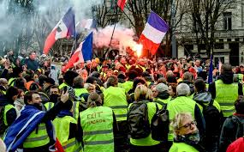
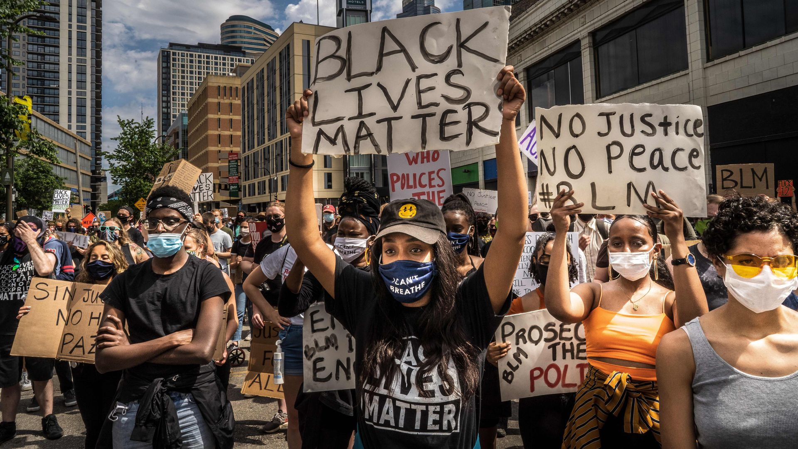
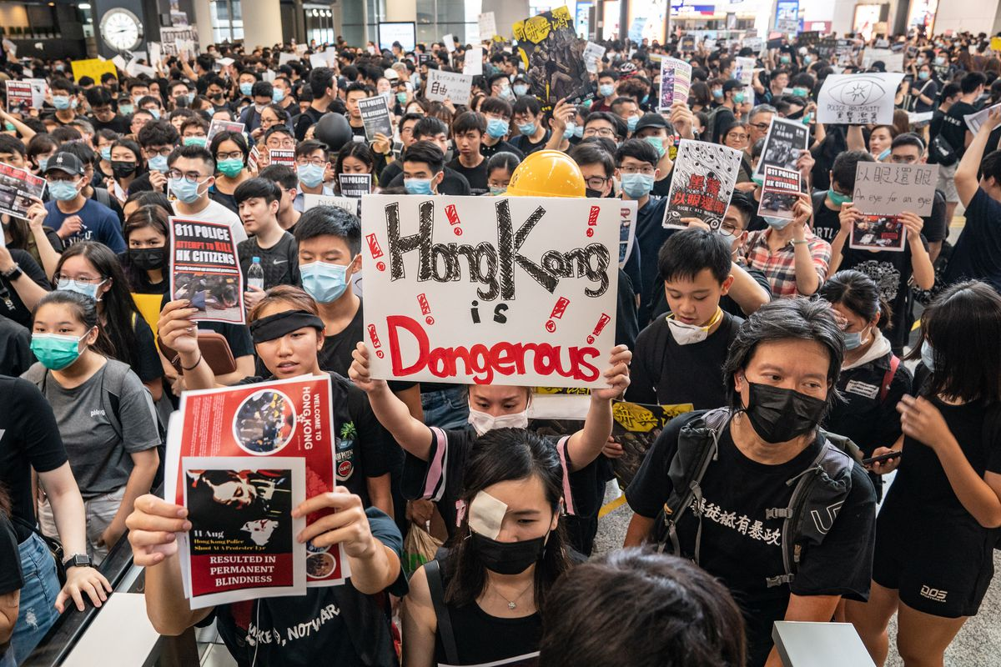
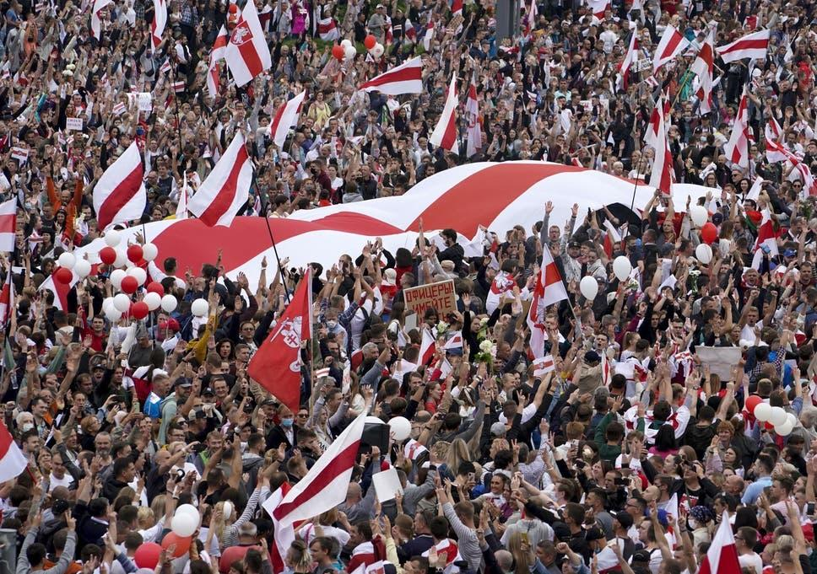
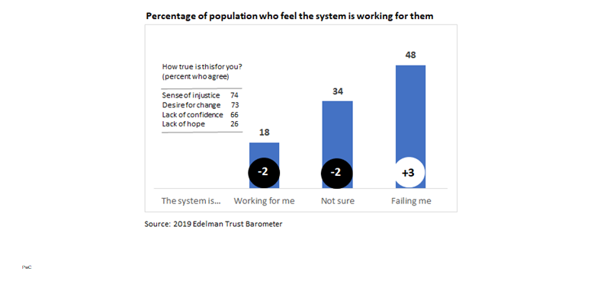
The crisis of institutional legitimacy
Institutions are dysfunctional…
…and under challenge
Percentage of population who feel the system is working for them
How true is this for you? (Percent who agree)
48%
Sense of injustice
74%
Desire for change
73%
34%
Lack of confidence
66%
Lack of hope
26%
18%
-2
-2
+3
The system is…
Working for me
Not Sure
Failing me
Source: 2019 Edelman Trust Barometer

Slide 8
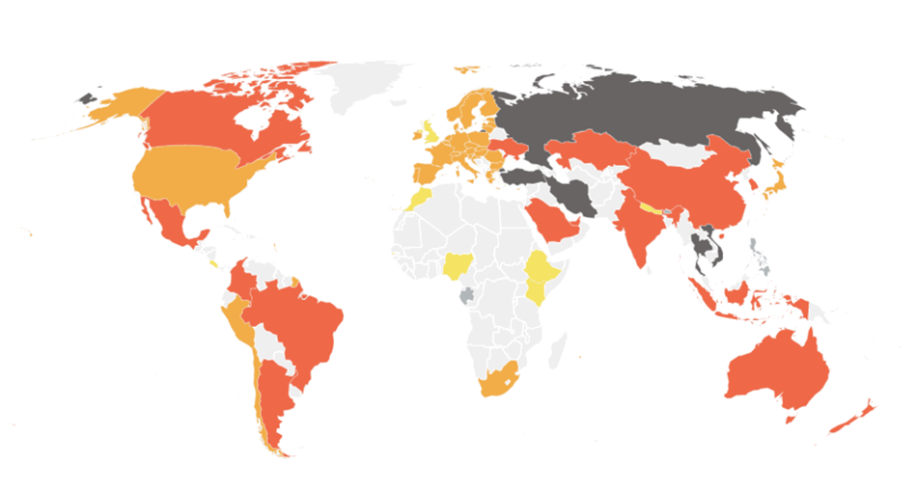
The crisis of leadership
Lack of climate leadership
Political polarization
Less overlap in the political values of Republicans and Democrats in the past
Distribution of Republicans and Democrats on a so-item scale of political values
1994
2017
1994
2017
Median Democrat
Median Democrat
Median Republican
Median Republican
95% of Republicans are more conservative than the median Democrat
97% of Democrats are more liberal than the median Republican
64% of
Republicans
76% of Democrats
Consistently liberal
Consistently conservative
Consistently liberal
Consistently conservative
Consistently liberal
Consistently conservative
Consistently liberal
Consistently conservative
% of Republican leaners who have a ____ opinion of the Democratic Party
% of Democrat leaners who have a ____ opinion of the Republican Party
81% Unfavorable
81% Unfavorable
68%
57%
45%
Very
Unfavorable
44%
Very
Unfavorable
17%
16%
1994
2017
1994
2017
Source: Climate Action Tracker (December 2021)
Source: Pew Research Center, October 2017
Notes:
Source: https://climateactiontracker.org/countries/ (visited Feb 2 2022, last update December 2021)

Slide 9
Then COVID happened and further accelerated ADAPT
A
Asymmetry
The poor (people, regions, countries) are being hit the hardest
Unemployment at the bottom of the wealth pyramid, which is also growing
Massive failure of small business
Sovereign debt and GDP growth issues
D
Disruption
Strength and influence of big technology platform companies is growing faster
In the short-term, climate worries are forgotten as the world deals with the crisis, but in the medium/long-term people are likely to become more socially conscious
Change in consumer habit here to stay (e.g. online shopping, remote learning)
New ways of working (e.g. remote/hybrid)
A
Age
Increased pressure on young countries as there are fewer workforce opportunities
Increased pressure on pensions and social welfare systems in older countries
Challenges stimulating job creation in developing markets compound the issue
Intergenerational debate
School closure leading to millions of children losing basic numeracy and literacy skills
P
Polarisation
Increased localisation of economies due to supply chain issues
Heightened nationalism as nation states look to blame “other” and protect themselves
The potential for humanity to come together after the crisis to solve important problems
Increasing polarization over vaccination and other virus containment measures
Using success in dealing with pandemic as proof point for political systems
T
Trust
Distrust in institutions and their ability to respond fairly is growing
Some institutions and leaders are coming out of the crisis with stronger reputation

Slide 10
We need to engage in a more sustainable way to create the future
Acceleration of
A
D
A
P
T
Economic conditions worsen
Shared global experience
Greater need for information and scrutiny
Restart
Repair
Ensure viability/strength Shutdown/bankruptcy
Rethink
Envision the future in order to manage today
Report
Meet stakeholder expectations for greater transparency
Reconfigure
Dramatic redesign
Acceleration of
Economic conditions worsen
Shared global experience
Greater need for information and scrutiny
Repair
Ensure viability/strength Shutdown/bankruptcy
Rethink
Envision the future in order to manage today
Report
Comply with expanded audit requirements
Restart
Reconfigure
Dramatic redesign

Slide 11
What does rethink look like?
Asymmetry
Fractured world:
Managing increased business complexities
Operating across regions in conflict with each other
Facing pressures to localise
Addressing mismatch between market and resources
Atmosphere:
Becoming net zero
Managing physical risk of climate change
Creating value when climate is a critical factor
Managing resource scarcity and biodiversity loss
A
Major transition addressing:
Disruption
Climate
Technology
Significant events
D
Age
Social:
Addressing systemic inequality
Addressing issues from demographic trends
Navigating and reducing polarisation
Reducing unintended consequences of technology
Technology:
Shaping industry disruption
Competing in a post-digital world
Increasing efficiency and effectiveness via technology
Building organizational and individual capabilities
A
Polarisation
P
Increased scrutiny requiring:
Trust
Trust: Having the organisation’s important stakeholders firmly believe in its reliability or ability to deliver the outcomes they expect
T

Slide 12
Implications for leadership
Problems/opportunities are:
Fractured world
Atmosphere
more ambiguous
more uncertain
NEW KIND OF LEADER
Social
Technology
more interdependent
… and they:
come faster
Trust
involve more stakeholders
happen in a more polarized world

Slide 13
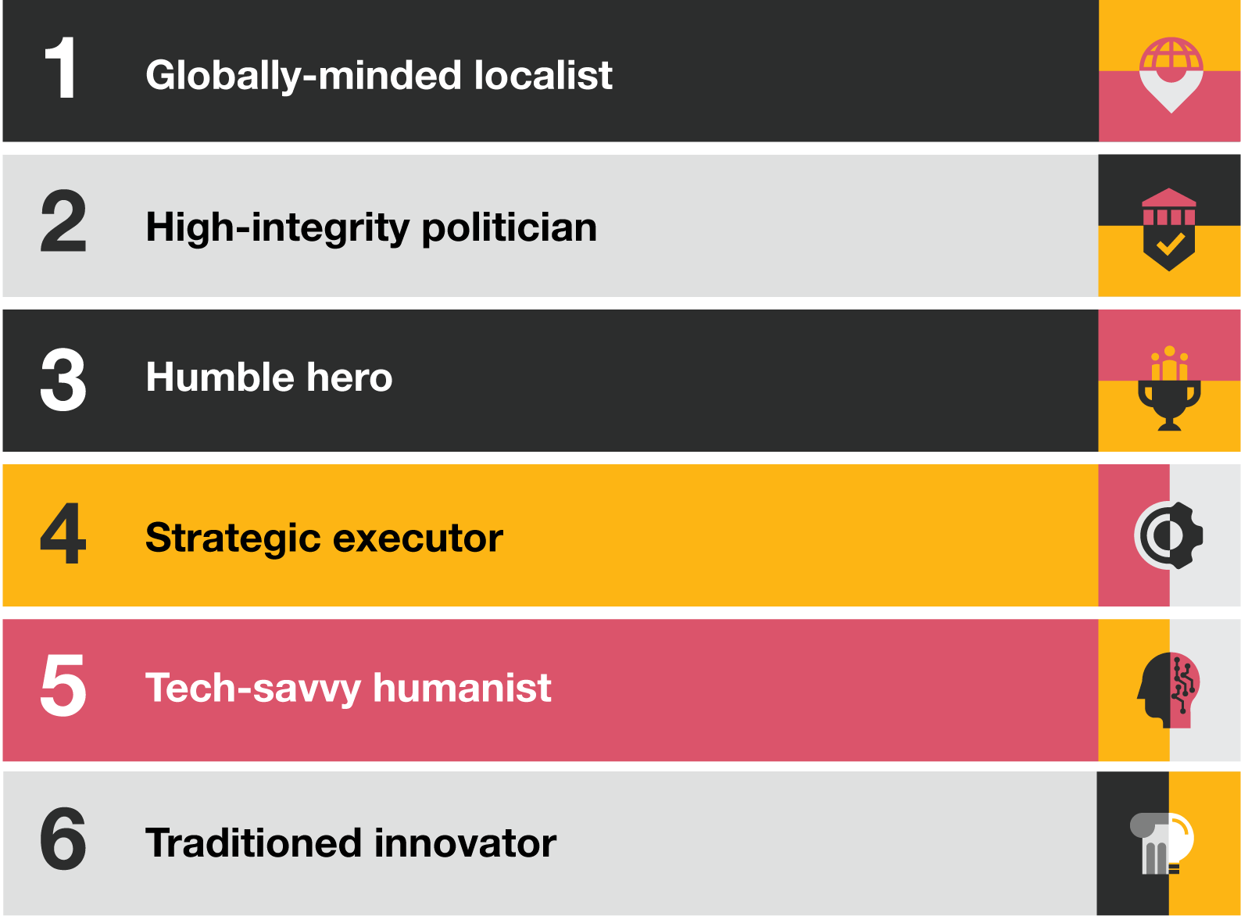
Six paradoxes of leadership
What characteristics define a great leader?

Slide 14
Thank you
© 2021 PwC. All rights reserved. Not for further distribution without the permission of PwC. “PwC” refers to the network of member firms of PricewaterhouseCoopers International Limited (PwCIL), or, as the context requires, individual member firms of the PwC network. Each member firm is a separate legal entity and does not act as agent of PwCIL or any other member firm. PwCIL does not provide any services to clients. PwCIL is not responsible or liable for the acts or omissions of any of its member firms nor can it control the exercise of their professional judgment or bind them in any way. No member firm is responsible or liable for the acts or omissions of any other member firm nor can it control the exercise of another member firm’s professional judgment or bind another member firm or PwCIL in any way.

